Slide 1
Triple integrals
The expression:
is called a triple integral and is evaluated by starting with the innermost integral and working outwards.
If the six limits on the integral are all constant the order in which the integrations are performed does not matter.
If the limits on the integrals involve some of the variables then the order in which the integrations are performed is crucial.

Slide 2
Summation in two directions
Double integrals
Triple integrals
Applications
Alternative notation
Determination of areas by multiple integrals
Determination of volumes by multiple integrals

Slide 3
Summation in two directions
Double integrals
Triple integrals
Applications
Alternative notation
Determination of areas by multiple integrals
Determination of volumes by multiple integrals

Slide 4
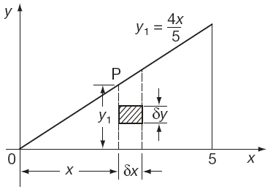
Applications
Example 1: To find the area bounded by the x-axis and the
ordinate at x = 5.

Slide 5
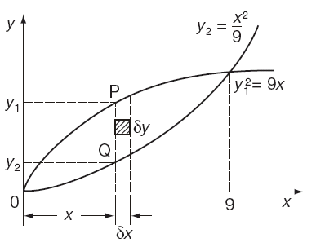
Applications
Example 2: To find the area enclosed by the curves and

Slide 6
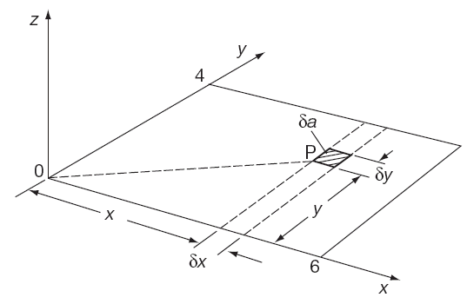
Applications
Example 3: Find the second moment of area of a rectangle 6 cm × 4 cm about an axis through one corner perpendicular to the plane of the figure.

Slide 7
Summation in two directions
Double integrals
Triple integrals
Applications
Alternative notation
Determination of areas by multiple integrals
Determination of volumes by multiple integrals

Slide 8
Summation in two directions
Double integrals
Triple integrals
Applications
Alternative notation
Determination of areas by multiple integrals
Determination of volumes by multiple integrals

Slide 9
Alternative notation
Sometimes double integrals are written in a different way. For example, the integral:
could have been written as:
Here the working starts from the right-hand side integral.

Slide 10
Summation in two directions
Double integrals
Triple integrals
Applications
Alternative notation
Determination of areas by multiple integrals
Determination of volumes by multiple integrals

Slide 11
Summation in two directions
Double integrals
Triple integrals
Applications
Alternative notation
Determination of areas by multiple integrals
Determination of volumes by multiple integrals

Slide 12
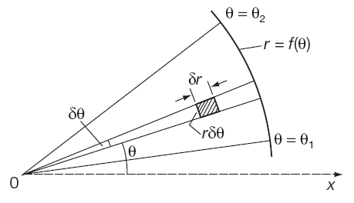
Determination of areas by multiple integrals
To find the area of the polar curve r = f (θ) between the radius vectors θ = θ₁ and θ = θ₂ it is noted that the area of an element is r.δr. δθ .
So the area in question is:

Slide 13
Summation in two directions
Double integrals
Triple integrals
Applications
Alternative notation
Determination of areas by multiple integrals
Determination of volumes by multiple integrals

Slide 14
Summation in two directions
Double integrals
Triple integrals
Applications
Alternative notation
Determination of areas by multiple integrals
Determination of volumes by multiple integrals

Slide 15
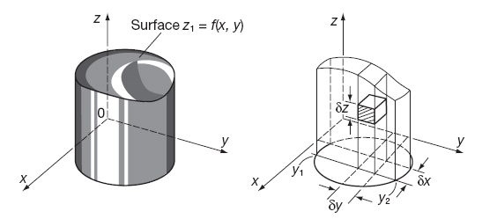
Determination of volumes by multiple integrals
The element of volume is:
Giving the volume V as:
That is:

Slide 16
Determination of volumes by multiple integrals
Example: Find the volume of the solid bounded by the planes z = 0, x = 1, x = 2, y = −1, y = 1 and the surface z = x² + y^{2.}

Slide 17
Learning outcomes
Determine the area of a rectangle using a double integral
Evaluate double integrals over general areas
Evaluate triple integrals over general volumes
Apply double integrals to find areas and second moments
Apply triple integrals to find volumes

